Slide 1
Explore Big Data
using
Simple Python Code
and
Amazon Cloud
Harikrishna Ravva

Slide 2
Agenda
Problem Statement
How Traditional Process works
Hadoop Map Reduce
Hadoop Streaming
Mapper and Reducer Python Code
Amazon EMR - Further Abstraction
Demo
Interesting Insights on Data

Slide 3
Top 10 web pages viewed in Wikipedia English During May
Rank | Page | Requests
1 | Malware | 7,885,529
2 | Falcon_9_v1.1 | 4,601,897
3 | Academy_Awards | 4,353,390
4 | Avengers:_Age_of_Ultron | 2,164,117
5 | 2015_in_spaceflight | 2,128,490
6 | Mad_Max:_Fury_Road | 1,769,086
7 | Nellie_Bly | 1,732,868
8 | Floyd_Mayweather | 1,716,975
9 | Plantronics_Headset | 1,660,100
10 | Sally_Ride | 1,620,413

Slide 4
Top 10 web pages viewed in Wikipedia English During June
Rank | Page | Requests
1 | Malware | 4,301,802
2 | Directoire_style | 3,392,602
3 | Jurassic_World | 2,794,012
4 | Flag_of_Arizona | 2,400,969
5 | Deaths_in_2015 | 1,755,530
6 | 2015_Copa_America | 1,676,423
7 | Game_of_Thrones | 1,665,987
8 | List_of_Game_of_Thrones_episodes | 1,467,040
9 | Game_of_Thrones_(season_5) | 1,423,251
10 | Christopher_Lee | 1,352,617

Slide 5
Top 10 web pages viewed in Wikipedia English During August
Rank | Page | Requests
1 | Nuclear_magnetic_resonance_spectroscopy | 7,129,740
2 | Galapagos_shark | 2,573,661
3 | am | 2,561,048
4 | Windex.php | 2,458,294
5 | What.CD | 1,990,772
6 | Deaths_in_2015 | 1,798,286
7 | Malware | 1,432,732
8 | Ddd | 1,292,970
9 | Donald_Trump | 1,204,890
10 | Tiananmen_Square_protests_of_1989 | 1,204,078

Slide 6
Top 10 web pages viewed in Wikipedia English During September
Rank | Page | Requests
1 | PlayStation_3 | 2,114,964
2 | Windex.php | 1,964,267
3 | Deaths_in_2015 | 1,763,752
4 | Pablo_Escobar | 1,414,870
5 | Ddd | 1,278,942
6 | Hillary_Clinton_presidential_campaign_2016 | 1,258,099
7 | An_Inspector_Calls | 1,173,259
8 | Google | 895,930
9 | List_of_Bollywood_films_of_2015 | 889,154
10 | Fear_the_Walking_Dead | 887,734

Slide 7
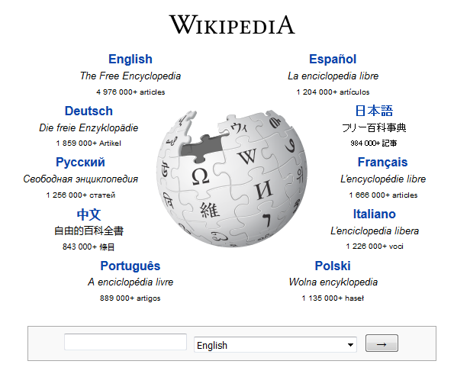
Wikipedia

Slide 8
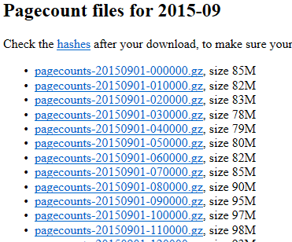
Wikipedia Log Files
Objective is to extract top 10 web pages viewed in one month
Record Structure :
Project PageName Requests Size
de Bagna_cauda 108 923292
es Sistema_Solar 252 13336552
en World_Bank 131 7275778
fr Tournoi_de_Wimbledon_2015 131 7180293
Notes:
Narrative:
Let us start by looking at the drivers which are causing a shift in the world of data and how it is analyzed. Big Data is a phenomenon and manifestation of a few recent trends in the industries. Click the link to read more about the shift in data and analysis.
For example: In 2011, 1.8 zettabytes of information were created globally and that amount is expected to double every year. The volume of data is the equivalent of 200 billion two-hour High Definition (HD) movies, which one person could watch for 47 million years straight. (Source: TechAmerica Foundation Big Data report)
Big Data handles huge data volumes from companies like Wal-Mart and Facebook. It drives value out of data-rich environments, which is not possible in traditional Relational Database Management Systems (RDBMS).
Big Data also incorporates outward focus found in data-driven decision making and data liberation wherein unstructured and semi-structured data can be used. Fluid frameworks lead to easier data modeling, exploration and maintenance. There is an increase in computing capacity due to flexible architecture.
Big Data integrates the cloud architecture leading to massive parallel computation as adopted by Facebook, Yahoo and Google. It imbibes social aspect and an exponential rise in the use of mobile phones and internet can be tapped. Big Data adapts to open source software such as RedHat, Cloudera and DataStax.
Click each label to read more about the recent shift in data and analysis.
Do NOT narrate this part:
On clicking Data Explosion
Unstructured data is doubling every three months
2011 saw 47 percent overall growth
By 2015, number of networked devices will be twice the global population
On clicking Monetization
Growth of enterprise data monetization services
Large retailers monetizing own data to provide insights to suppliers
On clicking Data-led Innovation
De-coupling data from applications
Disparate external data shaping context
Cost effective mobilization of massive scale data
On clicking Social Media
Emergence of companies that scrub and aggregate data from social media and blogs
Greater focus on data that provides insight in a customer’s digital persona
On clicking Technology
Commodity-priced storage and compute
Emergence of open source and Big Data technologies solving production problems at scale
On clicking Data Mobilization
Novel approaches to analyze unstructured data creating shorter time from data to insight
Shift towards data consumption in multiple environments (business applications, mobile, social)

Slide 9
Size of a month long log files of Wikipedia
Approx. Hourly Log File size : 100 MB in compressed Format and 400 MB uncompressed
In a Month = 400MB * 24(Hours) * 31(days) ≈ 300GB
Number of records in one month ≈ approximately 5 Billion.
Notes:
Narrative:
Let us start by looking at the drivers which are causing a shift in the world of data and how it is analyzed. Big Data is a phenomenon and manifestation of a few recent trends in the industries. Click the link to read more about the shift in data and analysis.
For example: In 2011, 1.8 zettabytes of information were created globally and that amount is expected to double every year. The volume of data is the equivalent of 200 billion two-hour High Definition (HD) movies, which one person could watch for 47 million years straight. (Source: TechAmerica Foundation Big Data report)
Big Data handles huge data volumes from companies like Wal-Mart and Facebook. It drives value out of data-rich environments, which is not possible in traditional Relational Database Management Systems (RDBMS).
Big Data also incorporates outward focus found in data-driven decision making and data liberation wherein unstructured and semi-structured data can be used. Fluid frameworks lead to easier data modeling, exploration and maintenance. There is an increase in computing capacity due to flexible architecture.
Big Data integrates the cloud architecture leading to massive parallel computation as adopted by Facebook, Yahoo and Google. It imbibes social aspect and an exponential rise in the use of mobile phones and internet can be tapped. Big Data adapts to open source software such as RedHat, Cloudera and DataStax.
Click each label to read more about the recent shift in data and analysis.
Do NOT narrate this part:
On clicking Data Explosion
Unstructured data is doubling every three months
2011 saw 47 percent overall growth
By 2015, number of networked devices will be twice the global population
On clicking Monetization
Growth of enterprise data monetization services
Large retailers monetizing own data to provide insights to suppliers
On clicking Data-led Innovation
De-coupling data from applications
Disparate external data shaping context
Cost effective mobilization of massive scale data
On clicking Social Media
Emergence of companies that scrub and aggregate data from social media and blogs
Greater focus on data that provides insight in a customer’s digital persona
On clicking Technology
Commodity-priced storage and compute
Emergence of open source and Big Data technologies solving production problems at scale
On clicking Data Mobilization
Novel approaches to analyze unstructured data creating shorter time from data to insight
Shift towards data consumption in multiple environments (business applications, mobile, social)

Slide 10
How traditional process works
Large and High Speed Database – Expensive, time consuming in loading the data, non linear in performance as data increases
File processing on High CPU /Memory Servers – Expensive, not possible to scale for large data due to hard disk speeds etc. Rerun if job fails.
In both the cases : Expensive Infrastructure, takes more time to provide the solution.
Notes:
Narrative:
Let us start by looking at the drivers which are causing a shift in the world of data and how it is analyzed. Big Data is a phenomenon and manifestation of a few recent trends in the industries. Click the link to read more about the shift in data and analysis.
For example: In 2011, 1.8 zettabytes of information were created globally and that amount is expected to double every year. The volume of data is the equivalent of 200 billion two-hour High Definition (HD) movies, which one person could watch for 47 million years straight. (Source: TechAmerica Foundation Big Data report)
Big Data handles huge data volumes from companies like Wal-Mart and Facebook. It drives value out of data-rich environments, which is not possible in traditional Relational Database Management Systems (RDBMS).
Big Data also incorporates outward focus found in data-driven decision making and data liberation wherein unstructured and semi-structured data can be used. Fluid frameworks lead to easier data modeling, exploration and maintenance. There is an increase in computing capacity due to flexible architecture.
Big Data integrates the cloud architecture leading to massive parallel computation as adopted by Facebook, Yahoo and Google. It imbibes social aspect and an exponential rise in the use of mobile phones and internet can be tapped. Big Data adapts to open source software such as RedHat, Cloudera and DataStax.
Click each label to read more about the recent shift in data and analysis.
Do NOT narrate this part:
On clicking Data Explosion
Unstructured data is doubling every three months
2011 saw 47 percent overall growth
By 2015, number of networked devices will be twice the global population
On clicking Monetization
Growth of enterprise data monetization services
Large retailers monetizing own data to provide insights to suppliers
On clicking Data-led Innovation
De-coupling data from applications
Disparate external data shaping context
Cost effective mobilization of massive scale data
On clicking Social Media
Emergence of companies that scrub and aggregate data from social media and blogs
Greater focus on data that provides insight in a customer’s digital persona
On clicking Technology
Commodity-priced storage and compute
Emergence of open source and Big Data technologies solving production problems at scale
On clicking Data Mobilization
Novel approaches to analyze unstructured data creating shorter time from data to insight
Shift towards data consumption in multiple environments (business applications, mobile, social)

Slide 11
Big Data Processing - Hadoop Map Reduce
Split the input files into blocks of 64MB or higher and distribute to multiple commodity computers(nodes) in the same network(cluster).
Process blocks by initiating multiple tasks on each node – Data Local
Replicate blocks among multiple nodes for fault tolerance
Notes:
Narrative:
Let us start by looking at the drivers which are causing a shift in the world of data and how it is analyzed. Big Data is a phenomenon and manifestation of a few recent trends in the industries. Click the link to read more about the shift in data and analysis.
For example: In 2011, 1.8 zettabytes of information were created globally and that amount is expected to double every year. The volume of data is the equivalent of 200 billion two-hour High Definition (HD) movies, which one person could watch for 47 million years straight. (Source: TechAmerica Foundation Big Data report)
Big Data handles huge data volumes from companies like Wal-Mart and Facebook. It drives value out of data-rich environments, which is not possible in traditional Relational Database Management Systems (RDBMS).
Big Data also incorporates outward focus found in data-driven decision making and data liberation wherein unstructured and semi-structured data can be used. Fluid frameworks lead to easier data modeling, exploration and maintenance. There is an increase in computing capacity due to flexible architecture.
Big Data integrates the cloud architecture leading to massive parallel computation as adopted by Facebook, Yahoo and Google. It imbibes social aspect and an exponential rise in the use of mobile phones and internet can be tapped. Big Data adapts to open source software such as RedHat, Cloudera and DataStax.
Click each label to read more about the recent shift in data and analysis.
Do NOT narrate this part:
On clicking Data Explosion
Unstructured data is doubling every three months
2011 saw 47 percent overall growth
By 2015, number of networked devices will be twice the global population
On clicking Monetization
Growth of enterprise data monetization services
Large retailers monetizing own data to provide insights to suppliers
On clicking Data-led Innovation
De-coupling data from applications
Disparate external data shaping context
Cost effective mobilization of massive scale data
On clicking Social Media
Emergence of companies that scrub and aggregate data from social media and blogs
Greater focus on data that provides insight in a customer’s digital persona
On clicking Technology
Commodity-priced storage and compute
Emergence of open source and Big Data technologies solving production problems at scale
On clicking Data Mobilization
Novel approaches to analyze unstructured data creating shorter time from data to insight
Shift towards data consumption in multiple environments (business applications, mobile, social)

Slide 12
Hadoop Map reduce
Notes:
Narrative:
Here are some examples of the use of analytics from Big Data. Read and make yourself familiar with the information provided.

Slide 13
Hadoop Streaming
API for Non Java
Unix Standard Input and Output Streams as Interface
Notes:
Narrative:
Here are some examples of the use of analytics from Big Data. Read and make yourself familiar with the information provided.

Slide 14
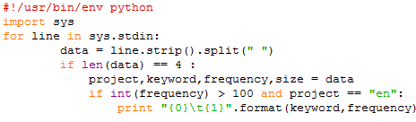
Mapper Code
Extract only Page Name and Requests from input file
de Bayern 1050 12130064
en Trap_music 28 3343116
en 2015_NHL_Entry_Draft 283 14861605
en Woody_Allen 134 12735915
en Triple_H 99 10773375
en ZIP_code 171 6605535
en 2015_Pan_American_Games 6601732
fr Tique 102 6928559
pt Chad_Mendes 218 3644225
2015_NHL_Entry_Draft 283
Woody_Allen 134
ZIP_code 171
Mapper
Notes:
Narrative:
Here are some examples of the use of analytics from Big Data. Read and make yourself familiar with the information provided.

Slide 15
Shuffle
Merge output from mappers and sort by key
Mappers output
Reducer Input
Woody_Allen 134
2015_NHL_Entry_Draft 283
ZIP_code 171
2015_NHL_Entry_Draft 200
2015_NHL_Entry_Draft 283
Woody_Allen 134
Triple_H 300
ZIP_code 171
ZIP_code 400
Shuffle
ZIP_code 400
2015_NHL_Entry_Draft 200
Triple_H 300
Notes:
Narrative:
Here are some examples of the use of analytics from Big Data. Read and make yourself familiar with the information provided.

Slide 16
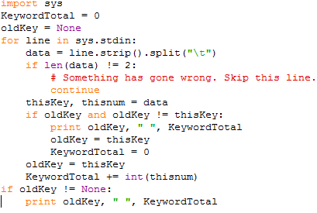
Reducer
Aggregate the total views for each page
2015_NHL_Entry_Draft 200
2015_NHL_Entry_Draft 283
Woody_Allen 134
Triple_H 300
ZIP_code 171
ZIP_code 400
2015_NHL_Entry_Draft 483
Woody_Allen 134
Triple_H 300
ZIP_code 571
Reducer
Notes:
Narrative:
Here are some examples of the use of analytics from Big Data. Read and make yourself familiar with the information provided.

Slide 17
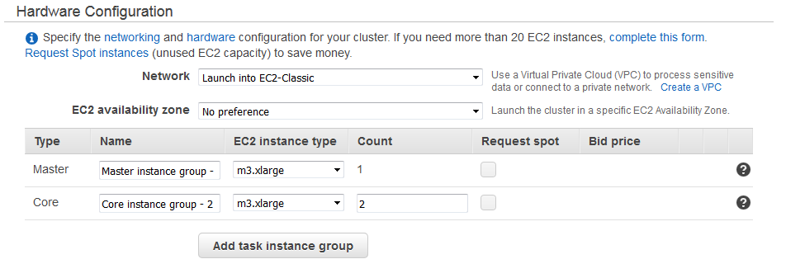
Amazon EMR
Creates and Configure Hadoop Cluster in Amazon Cloud
Abstracts Administration
Notes:
Narrative:
Here are some examples of the use of analytics from Big Data. Read and make yourself familiar with the information provided.

Slide 18
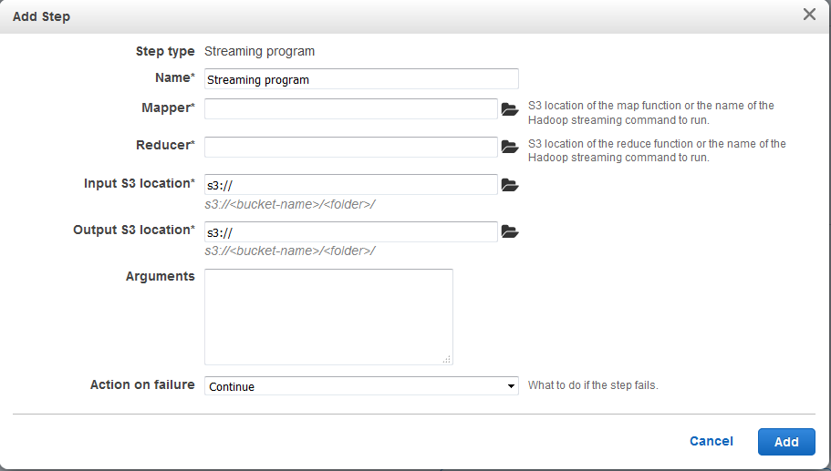
Amazon EMR Contd..
Notes:
Narrative:
Here are some examples of the use of analytics from Big Data. Read and make yourself familiar with the information provided.

Slide 19
Demo
Extract Data from Wikipedia
Create Hadoop Cluster in Amazon EMR
Execute the Map Reducer Job
Job Monitoring
Output
Notes:
Narrative:
Here are some examples of the use of analytics from Big Data. Read and make yourself familiar with the information provided.

Slide 20
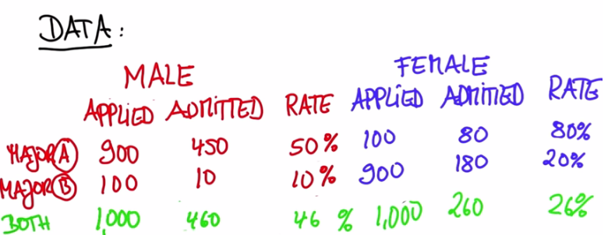
Simpson’s Paradox
A trend that appears in different groups of data disappears or reverses when these groups are combined
Statistics are like alienists - They will testify for either side
-- Fiorella La Gaurdia
Notes:
Narrative:
Here are some examples of the use of analytics from Big Data. Read and make yourself familiar with the information provided.

Slide 21
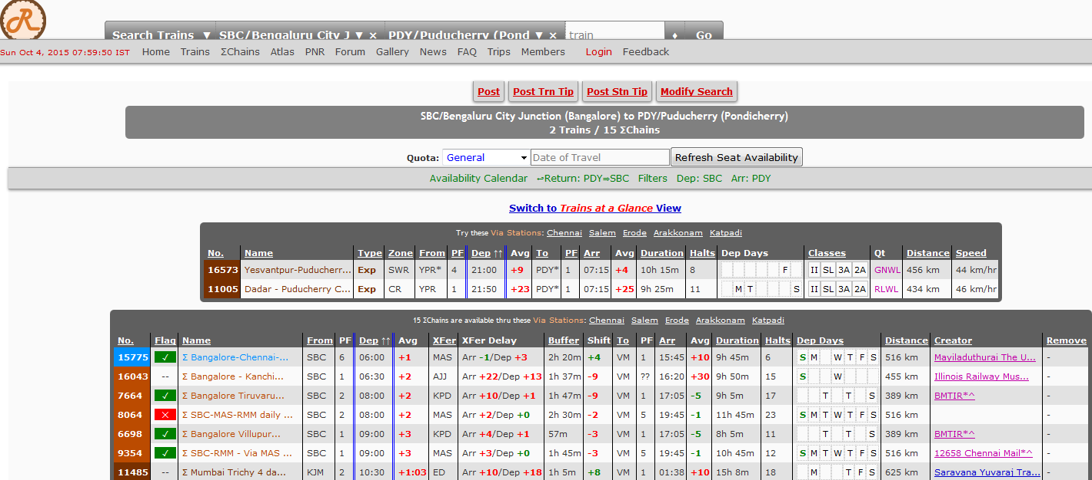
Another Community Driven Big Dataset
Indiarailinfo.com
Notes:
Narrative:
Here are some examples of the use of analytics from Big Data. Read and make yourself familiar with the information provided.

Slide 22
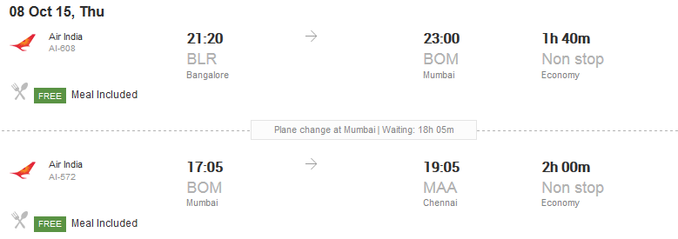
Commercial Travel Aggregator
Chennai to Bangalore Via Mumbai with Wait of 18 hours !!
Notes:
Narrative:
Here are some examples of the use of analytics from Big Data. Read and make yourself familiar with the information provided.

Slide 23
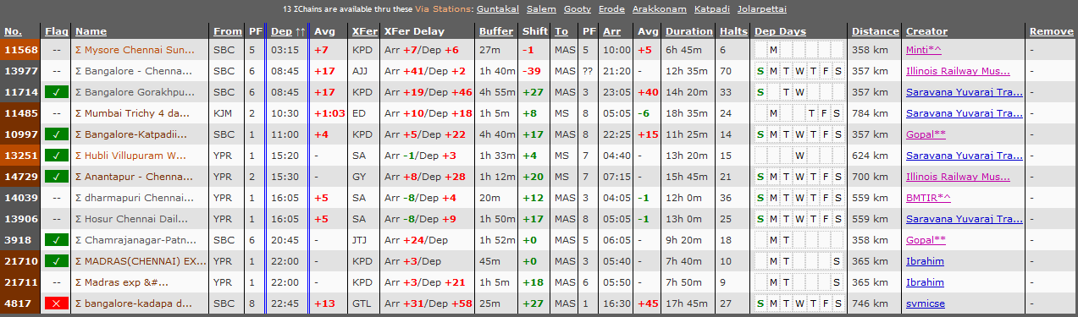
Vs Community Website
Maximum Waiting time is 4 hours ☺
Notes:
Narrative:
Here are some examples of the use of analytics from Big Data. Read and make yourself familiar with the information provided.

Slide 24
Tools Used
Python
Ipython
Amazon AWS
Shell Programming
Hadoop Map Reduce
Detailed Instructions for this exercise available in GitHub :
Steps to extract the data from Wikipedia to s3 ( of Amazon AWS)
Execute the Hadoop Map Reduce Job using Amazon EMR
Monitoring the jobs and other administrative tasks
GitHub Link : https://github.com/ravvas/Pycon2015
Notes:
Narrative:
Here are some examples of the use of analytics from Big Data. Read and make yourself familiar with the information provided.

Slide 25
Questions?
Be Fair while downloading data from public sources like Wikipedia
Notes:
Narrative:
Here are some examples of the use of analytics from Big Data. Read and make yourself familiar with the information provided.

Slide 26
Reference/credits
Udacity.com – online education portal mainly focused on Python.
Bangpypers – Python Meetup in Bangalore
Amazon AWS documentation
Notes:
Narrative:
Here are some examples of the use of analytics from Big Data. Read and make yourself familiar with the information provided.

Slide 27
Appendix
Notes:
Narrative:
Here are some examples of the use of analytics from Big Data. Read and make yourself familiar with the information provided.

Slide 28
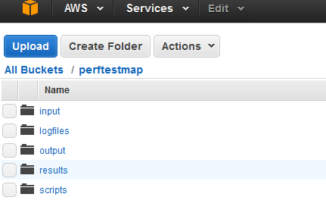
S3 Folder Structure
Notes:
Narrative:
Here are some examples of the use of analytics from Big Data. Read and make yourself familiar with the information provided.

Slide 29
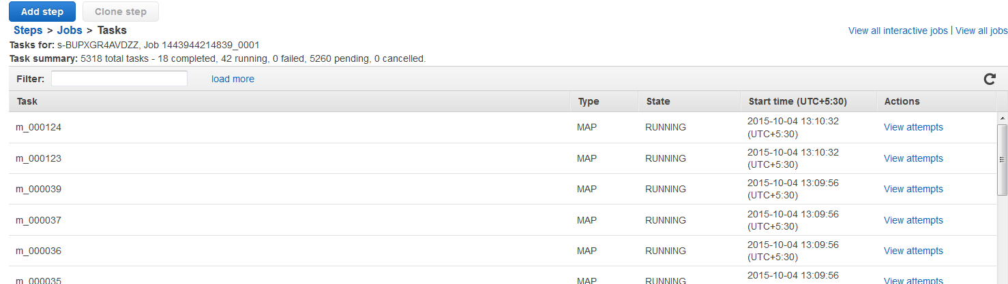
Job Running
Notes:
Narrative:
Here are some examples of the use of analytics from Big Data. Read and make yourself familiar with the information provided.

Slide 30
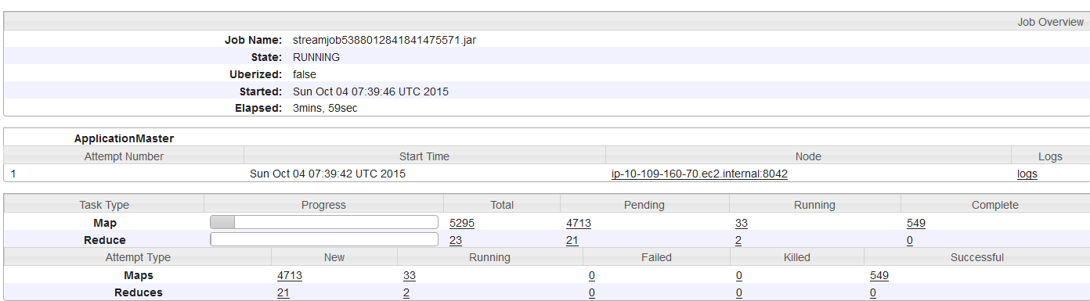
Hadoop Web connector – Job Summary
Notes:
Narrative:
Here are some examples of the use of analytics from Big Data. Read and make yourself familiar with the information provided.

Slide 31
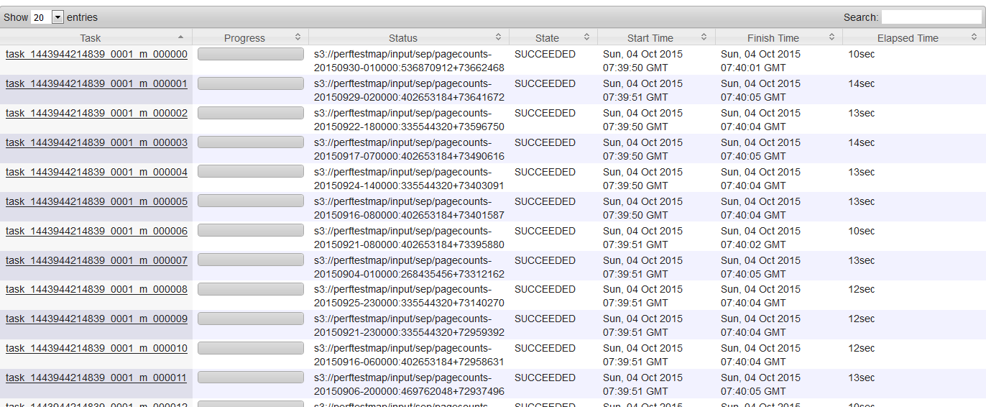
Hadoop Web connector – Map Tasks Details
Notes:
Narrative:
Here are some examples of the use of analytics from Big Data. Read and make yourself familiar with the information provided.

Slide 32
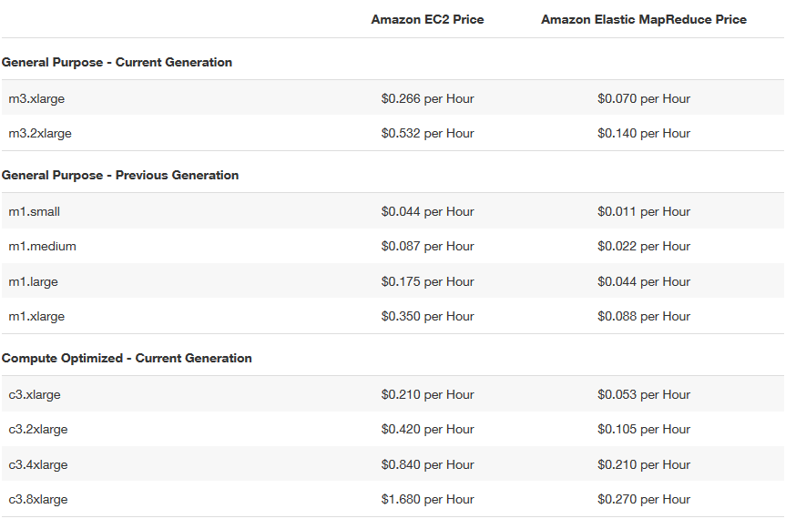
EMR Pricing
Notes:
Narrative:
Here are some examples of the use of analytics from Big Data. Read and make yourself familiar with the information provided.

Slide 33
Hadoop Map reduce
MapReduce jobs consists of
Map phase - reads the local file data block(s); extracts the fields of interest and assigns an aggregating key; and releases the extract records to the shuffle phase
Shuffle phase - sorts the extract records by key; ships records of each group of keys to Datanodes where the Reduce phase takes place.
Reduce phase - reads the records received from the shuffle phase; performs whatever aggregation is required ; writes its block to HDFS.
The blocks are named using a sequence number, so that the individual reduction file blocks can be reassembled in proper order.
Notes:
Narrative:
Here are some examples of the use of analytics from Big Data. Read and make yourself familiar with the information provided.

